Slide 1
MTG Nowcasting for East Africa
Steve Goodman/TGA
GOES-R Senior Scientist (Retired)
Huntsville, AL USA
2021 CWG Virtual Meeting
6-8 April 2021
Notes:
Multiple sponsors for this Project- NASA, NOAA, WMO, Met Office
WISER- Weather and Climate Information Services for Africa
Highway- October 2017-March 2021
I was appointed to the WMO World Weather Research Program (WWRP) Working Group on Nowcasting Research (WGNR) by US Permanent Representative and NWS Director Gen. Kelly to serve two terms (8 years) on the WG. The WGNR started discussions with WMO in Geneva in 2014; the head of the Severe Weather Forecasting Program brought this issue of fatalities on the lake WGNR Working Group asking how we might help. We began with a proposal to the NSF in US for funding and in 2017 the UK WISER/DFID Program provided funding at a reduced level.

Slide 2
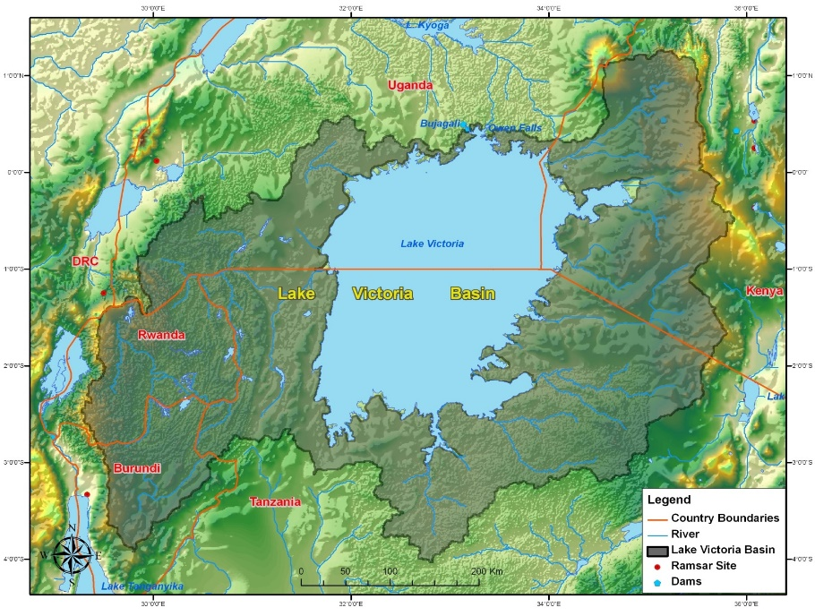
Lake Victoria Basin
Uganda
DRC
Kenya
Rwanda
Burundi
Tanzania
Black polyline shows the horizontal extent of LVB. Orange polylines mark the boundaries of the five countries in the basin: Uganda, Kenya, Tanzania, Burundi and Rwanda. Courtesy of Lake Victoria Basin Commission
Notes:
TA4 model domain.
HIGHWAY focus on storms over Lake Victoria, however the large Rift Valley Lakes (Albert, Tanganyika, Malawi) to the west also exhibit the same nocturnal thunderstorm activity as LV

Slide 3
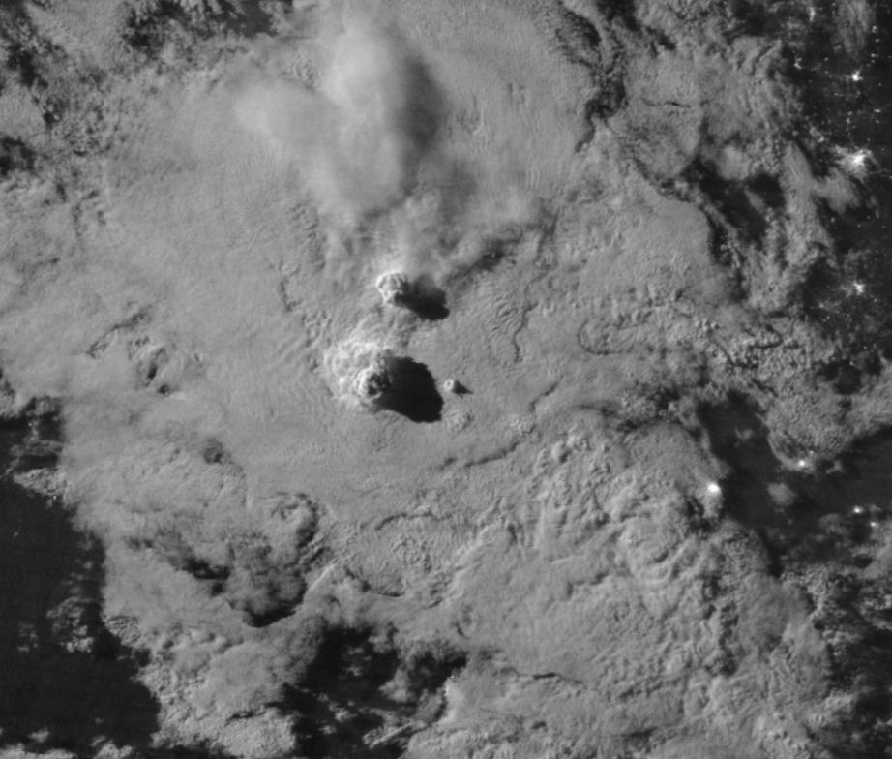
VIIRS DNB
15 Feb. 2019
Notes:
VIIRS DNB 15 FEBRUARY 2019. Cloud top shadows dramatic. (courtesy NASA and Steve Miller, CSU)
We had hoped to see the boats lights of fishermen, but their lanterns or iphones illumination too small to be seen from space- not like Sea of Japan Shrimp boats.
In early planning for satellite data sets we considered S-NPP and/or NOAA 20 VIIRS for high resolution Lake SST (GHRSST) or looking at scatterometer data for wind waves, but that ended up being beyond the scope of resources and time. Still a good thing to consider going forward.

Slide 4
Questions: Research and Applications
What can satellite (imagery, lightning) products provide - to complement or diagnose convection where sparse/absent radars?
What lightning data sets are available and of what data quality
How good/useful is global NWP? Short-range NWP?
MTG 4D Data Cube – Expectations for higher spatial, spectral, temporal resolution over East Africa? IRS - 6 hr, FCI - 10 min, LI – 30 s
Lessons learned from Highway Project
These questions are relevant to the global observing system and the operational use of MTG and the new generation GEO-Ring
(Multispectral imagers, Lightning Imagers, Infrared Sounders)
Notes:
New GEO-Ring to support the WMO WIGOS 2040 Vision
Training- Ralph Peterson, Estelle de Coning and I did Nowcasting training for EA NMHS in 2016 in Addis Ababa. At that meeting a forecaster from Burundi told me they consider rainhats of 25 mm/h to be severe due to the complex topography. He also said when they see storms propagating SW across the lake they can estimate when Burundo will be hit some number of hours later, so Nowcasting for propagation and tracking is useful.
MTG will be a transformational advancement for weather services throughout Africa providing 10-min full disk, multi-spectral imagery with greater spatial, temporal and spectral information from its FCI, 30-sec total lightning from its LI, and 6-hourly soundings over the LVB of the pre-storm and near-storm environment from its IRS, as well as sub-hourly soundings equivalent to those provided by MSG-SEVIRI from MTG-I channels. New satellite products will combine the lightning, imager, and sounder into a “seamless” 4-D data cube that can be combined with NWP and radar.

Slide 5
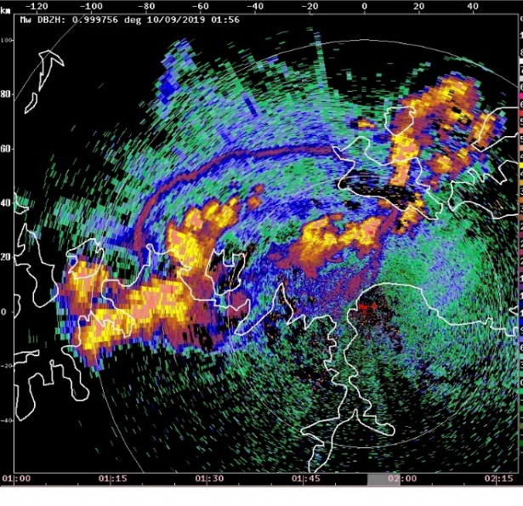
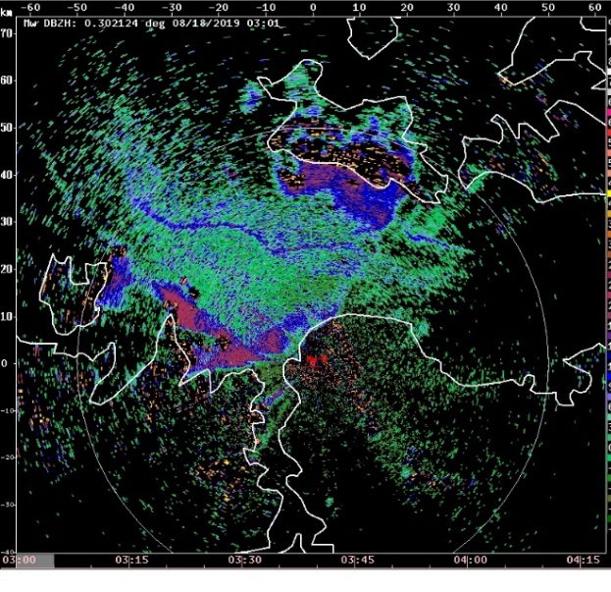
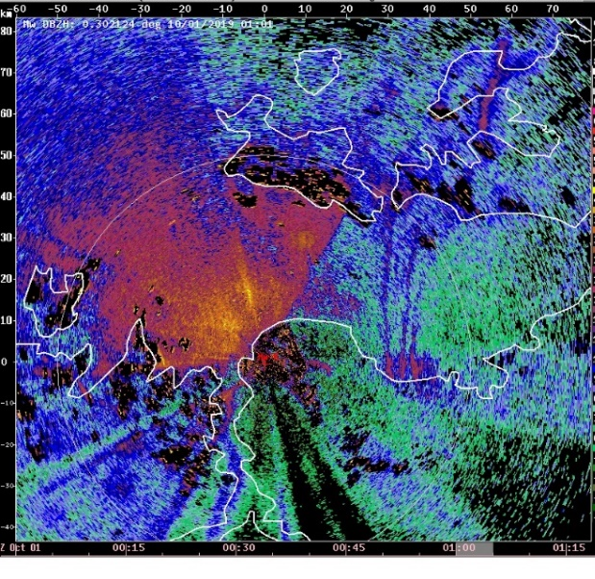
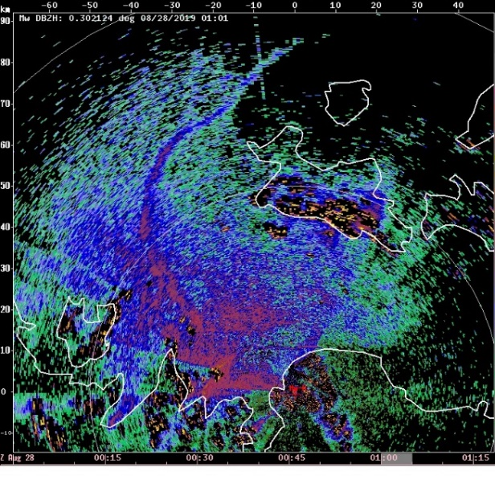
a)Gust front 9 Oct 2019 01:56 UTC
b) Land Breeze front 18 Oct 2019 03:01 UTC
Mwanza radar reflectivity from four different days (a)-(d) showing examples of thin lines associated with boundary layer convergence and subsequent CI over Lake Victoria.
Radar range rings (light gray) at 50 km are shown.
The large region of 15-35 dBZ echo to the NW of the radar over the lake in (c) is from biological scatters.
Ukerewe Island
50 km
Mwanza
50 km
c) Gravity waves 1 Oct 2019 01:01 UTC
d) Unknown 28 Oct 2019 01:01 UTC
50 km
Visit NCAR field project catalog for data set access
https://data.eol.ucar.edu/project/HIGHWAY
Radar Reflectivity (dBZ)
Notes:
Mwanza radar reflectivity field from four different days (a)-(d) showing examples of thin lines associated with boundary layer convergence lines over Lake Victoria. The white polyline is the southern shore of Lake Victoria. The white arrows point to the boundary location in each panel. The yellow arrows in (c) point to unknown boundaries. All these boundaries initiated storms. The location of Ukerewe island, the largest island in Lake Victoria, is shown in (b). Radar range rings (light gray) at 50 km are shown. The red cross is the Mwanza radar location. The large region of 15-35 dBZ echo to the NW of the radar over the lake in (c) is from biological scatters.

Slide 6
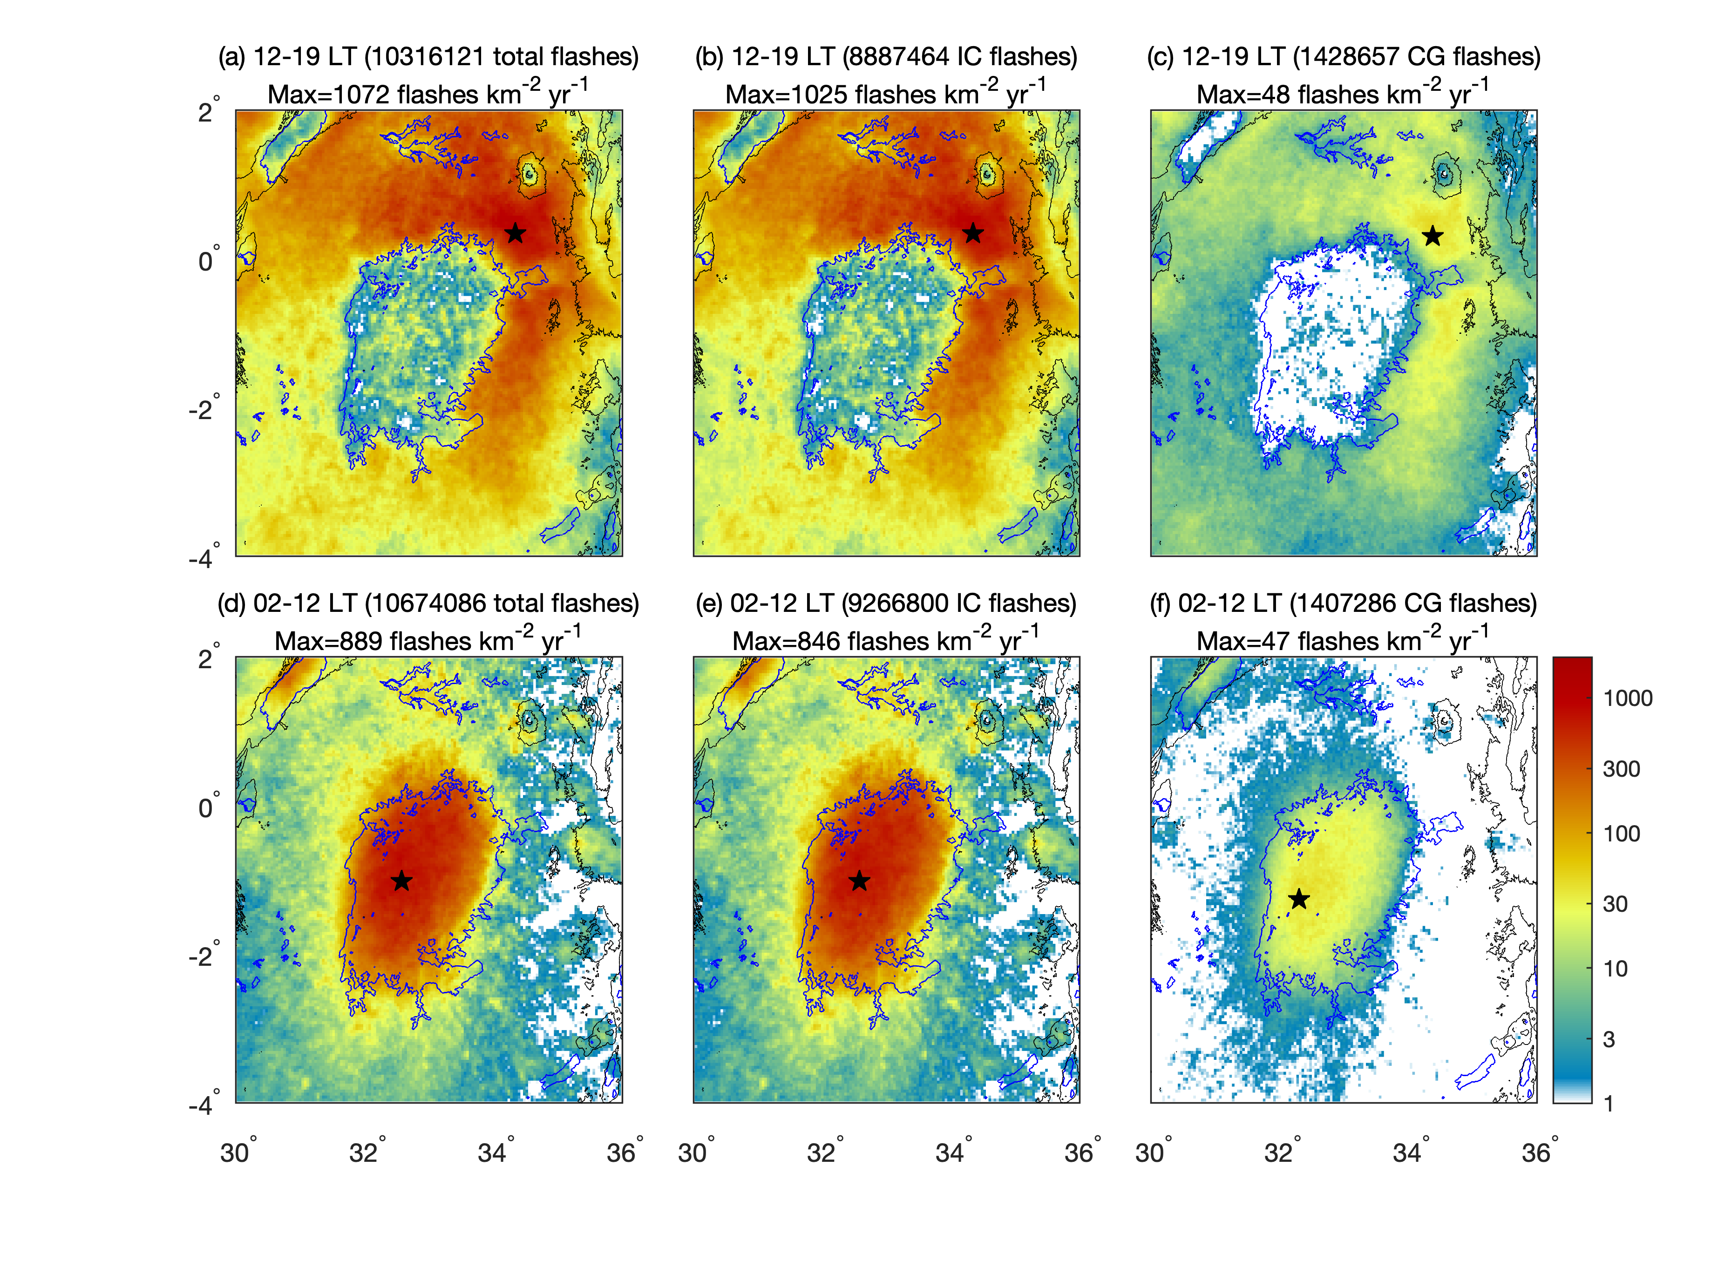
Nocturnal Thunderstorms over Lake Victoria
Day
Night
Virts and Goodman, MWR, 2020
Notes:
Diurnal lightning activity, 2014-2020 Climatology – Virts, K. S, and S. J. Goodman, 2020: Prolific lightning and thunderstorm initiation over the Lake Victoria Basin in East Africa. Mon. Wea. Rev.,, https://doi.org/10.1175/MWR-D-19-0260.1.
Nocturnal thunderstorms over the lake has been known. Prior TRMM LIS satellite lighting climatology, Albrecht et al., BAMS, 2016.
Note the other large Rift Valley lakes similarly have nocturnal thunderstorms – Tanganyika, Malawi, Albert

Slide 7
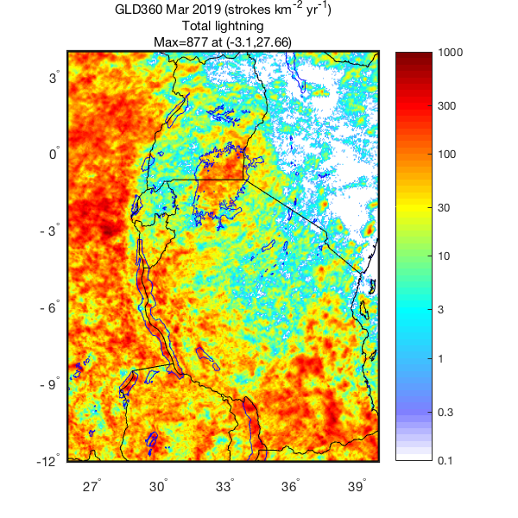
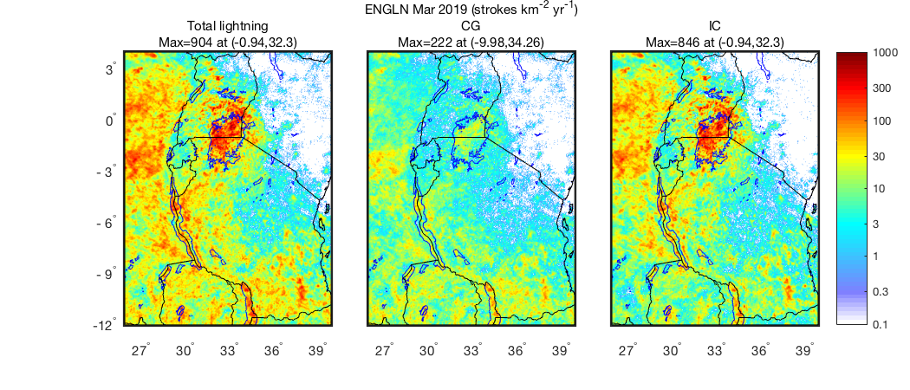
March 2019 Monthly Lightning
GLD360
ENGLN
ENGLN
ENGLN
Virts, K. S, and S. J. Goodman, 2020: Prolific lightning and thunderstorm initiation over the Lake Victoria Basin in East Africa. Mon. Wea. Rev.,, https://doi.org/10.1175/MWR-D-19-0260.1.
Notes:
Chose ENGLN for better DE of total lightning over the lake. Note EAT is UTC+3 hours. The added information from a ground based network added to MTG LI could be value added for characterizing the lightning and thunderstorms.

Slide 8
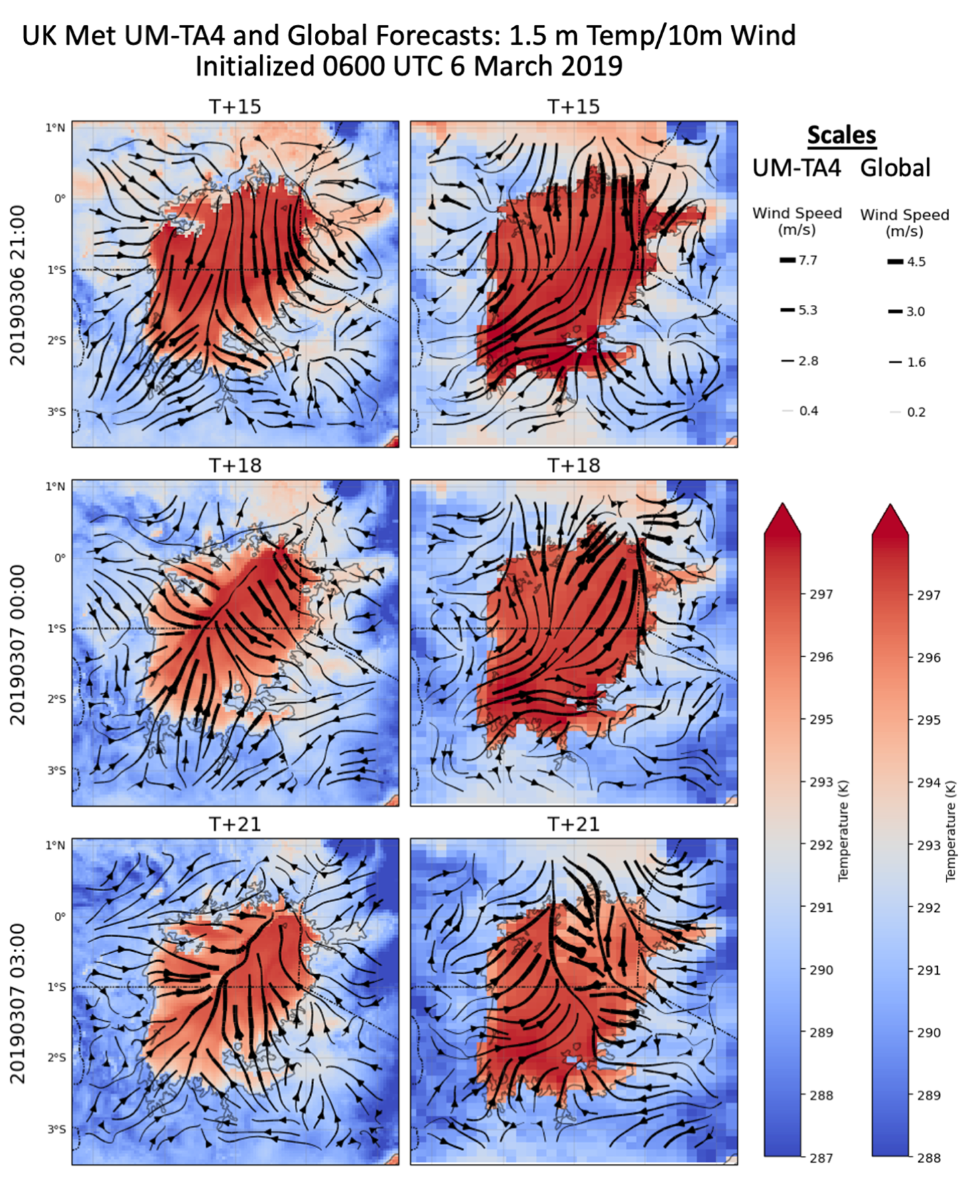
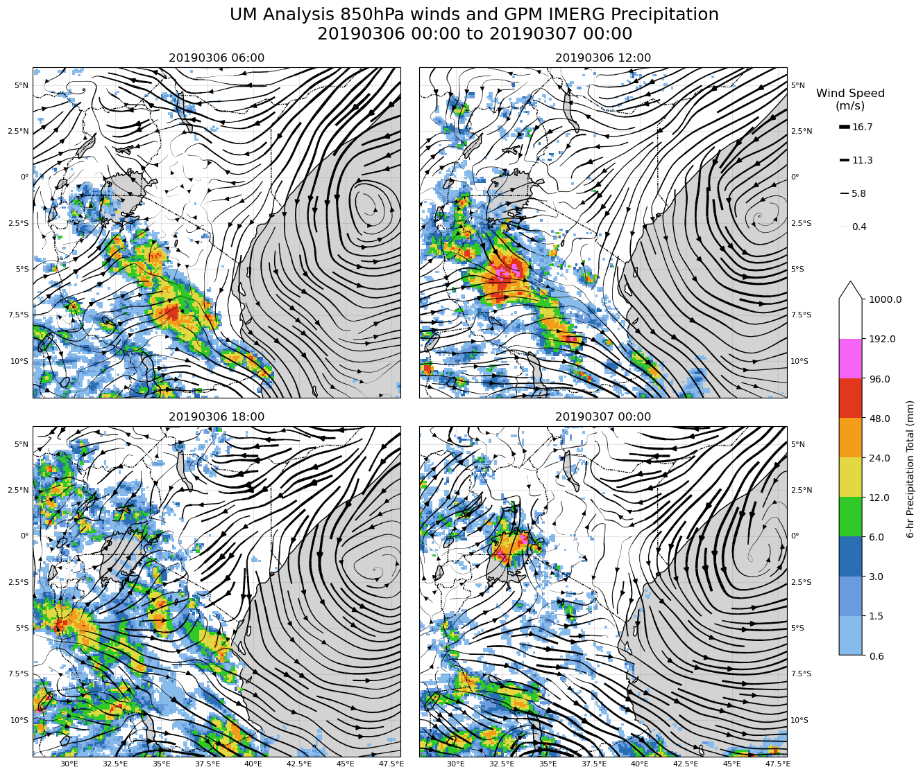
6 Mar. 2019 Environmental Setting: NWP – Met Office UM Global Model and TA4 Tropical Africa 4.4 km model
UK Met Office global operational analyses of 850 hPa winds superimposed on the GPM IMERG 6-hour accumulated precipitation (mm) at 06, 12, 18 and 24 UTC on 6 March . Lake Victoria (-1S, 32.5E highlighted in gray).
Tropical Africa Model forecasts of surface temperature (1.5 m), and 10 m wind valid at 2100 UTC on 6 March and 0000 and 0300 UTC March 7. Left column UM-TA4 and right column from UK-UM . Note that different scales for each model.
Notes:
Lightning Forecast (used in TA4) and Nearcast initially developed under GOES-R PGRR Science Program
UM global provides boundary conditions for the TA4. TA4 run at 06 and 18Z. With IRS soundings every 6 hours, the regional and global models can be expected to be more accurate.
Note the TA4 convergence toward north shore of lake, not in the UM. The winds in the center of the lake at ))Z are 90 degrees different so UM global misses the convergence in the NE part of the lake. AMVs from MTG FCI and IRS can also help track the low level flow.- Note at night VIS imagery not likely to be a help.

Slide 9
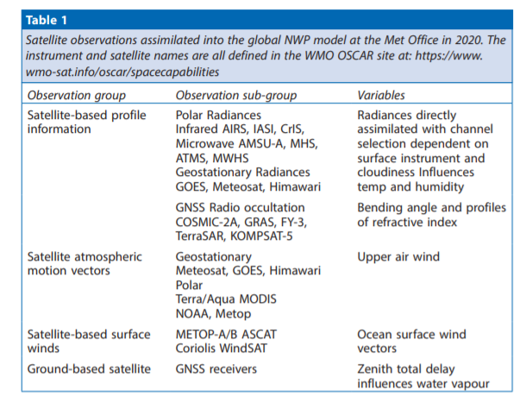
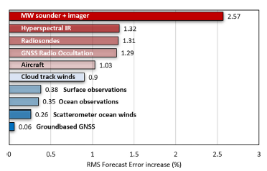
The Use of Satellite NWP at the Met Office
MTG-FCI/IRS possible
improvements for Africa?
Percentage increase in root mean square forecast errors when different observation types are removed from the Met Office NWP model for the period from 23 August to 15 November 2019. The errors are based on the 6 to 144-hour forecasts for a few key parameters (temperature, wind and geopotential, at levels between the surface and 250hPa). The ECMWF analysis is used as a proxy for the truth (Saunders, RMetS, March 2021, 76, No. 3.
Notes:
The TA4 does not assimilate any other data. The UM is the boundary condition for the TA4 (courtesy Andy Hartley, Met Office).

Slide 10
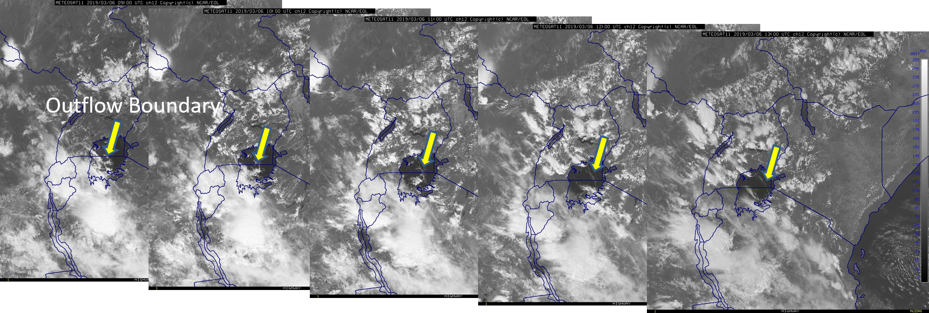
^{MSG SEVERI}
6 March 2019
An outflow boundary propagates northward across the lake, then dissipates

Slide 11
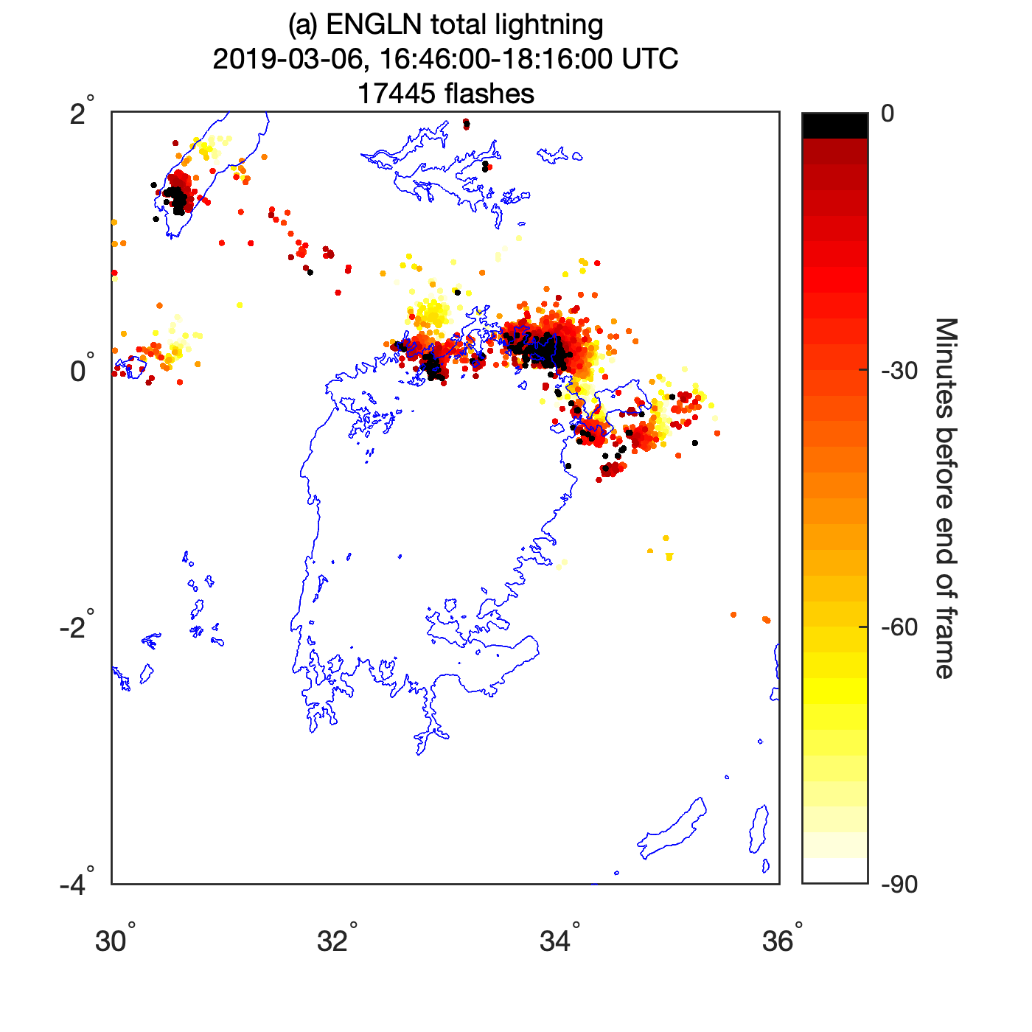
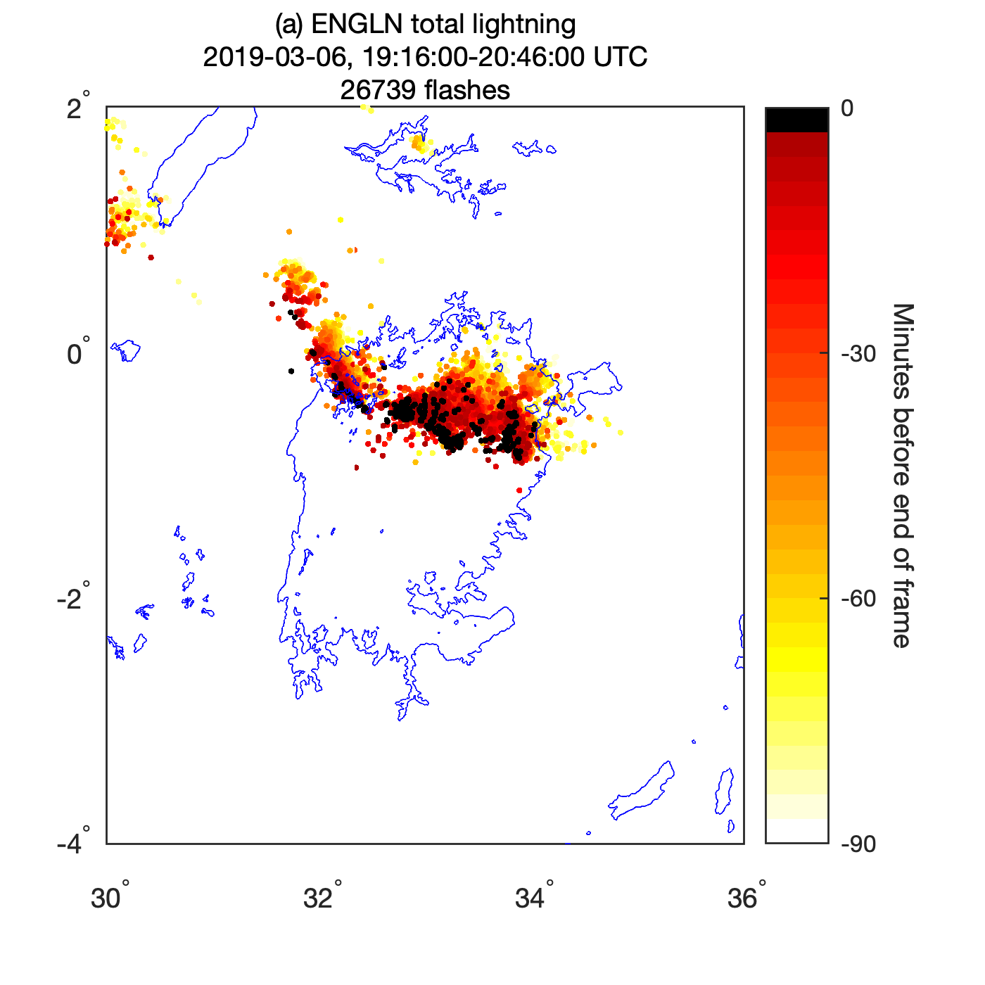
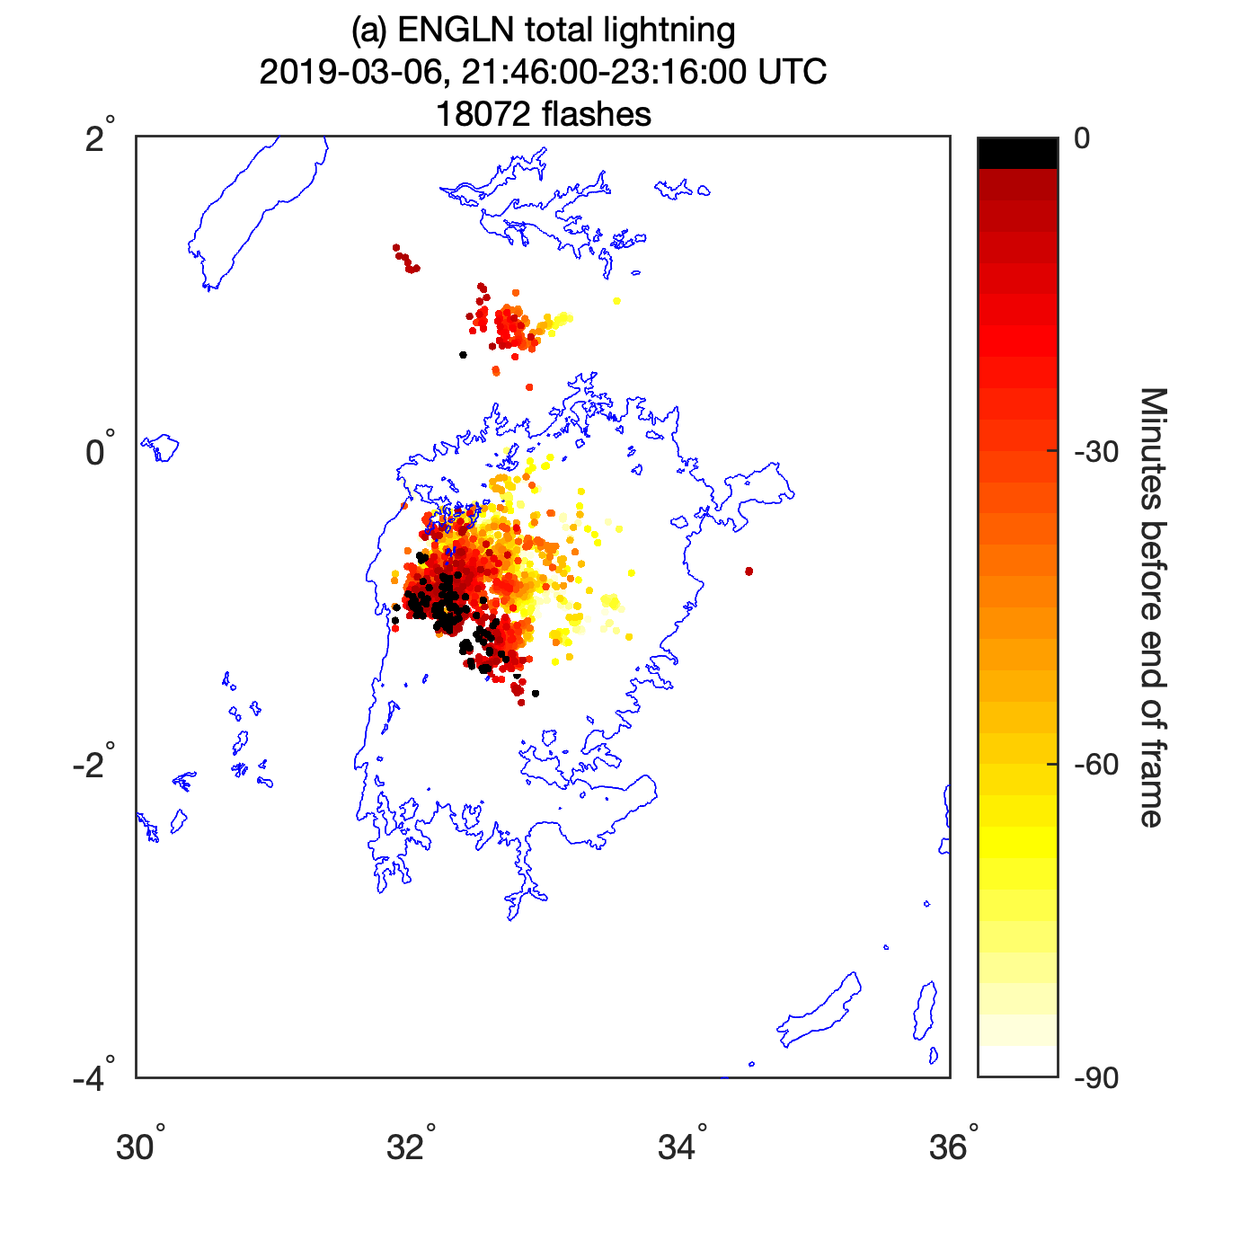
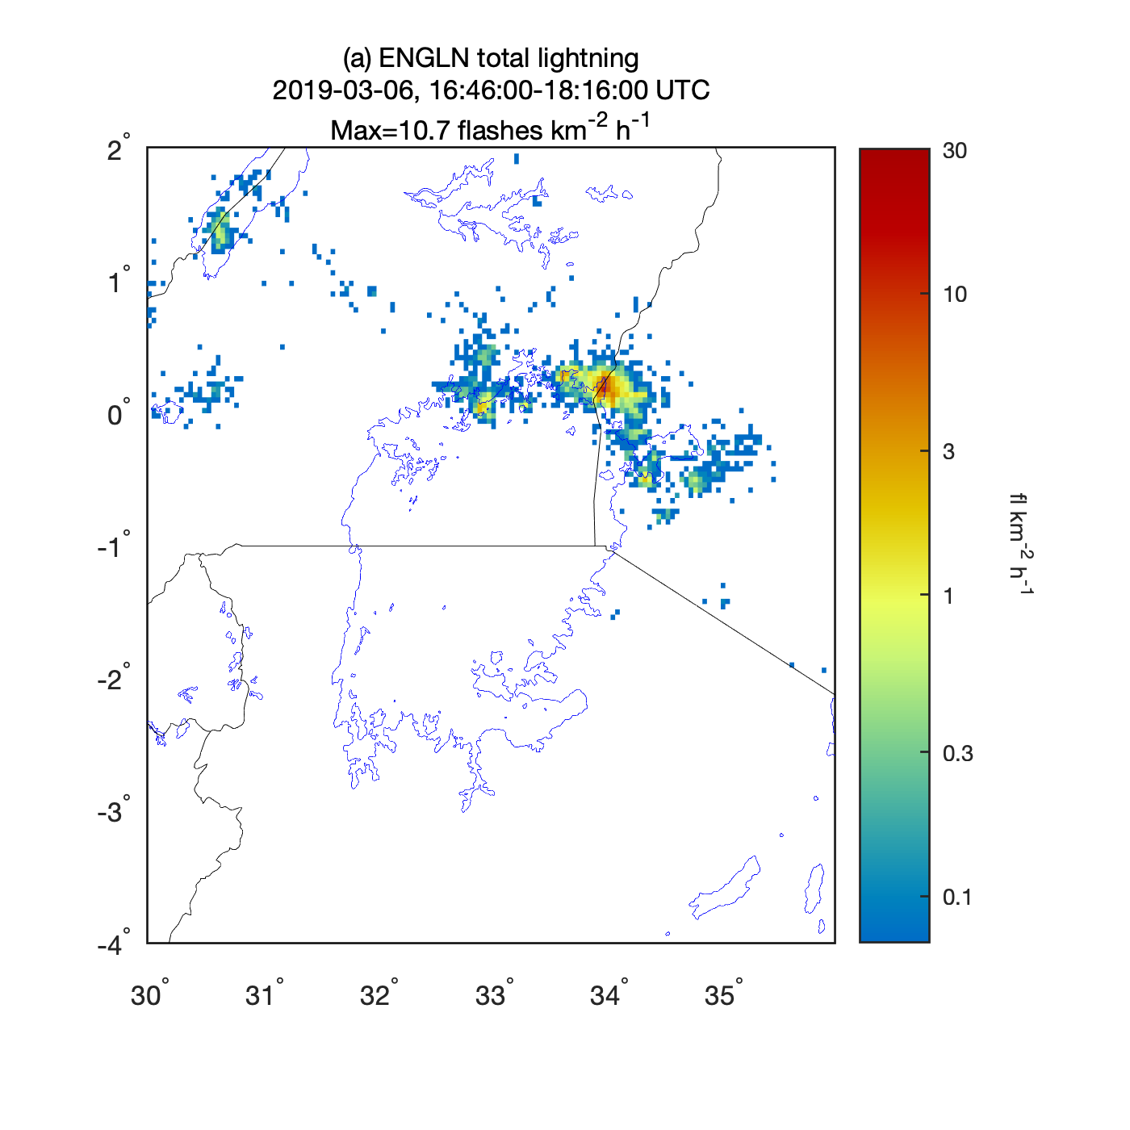
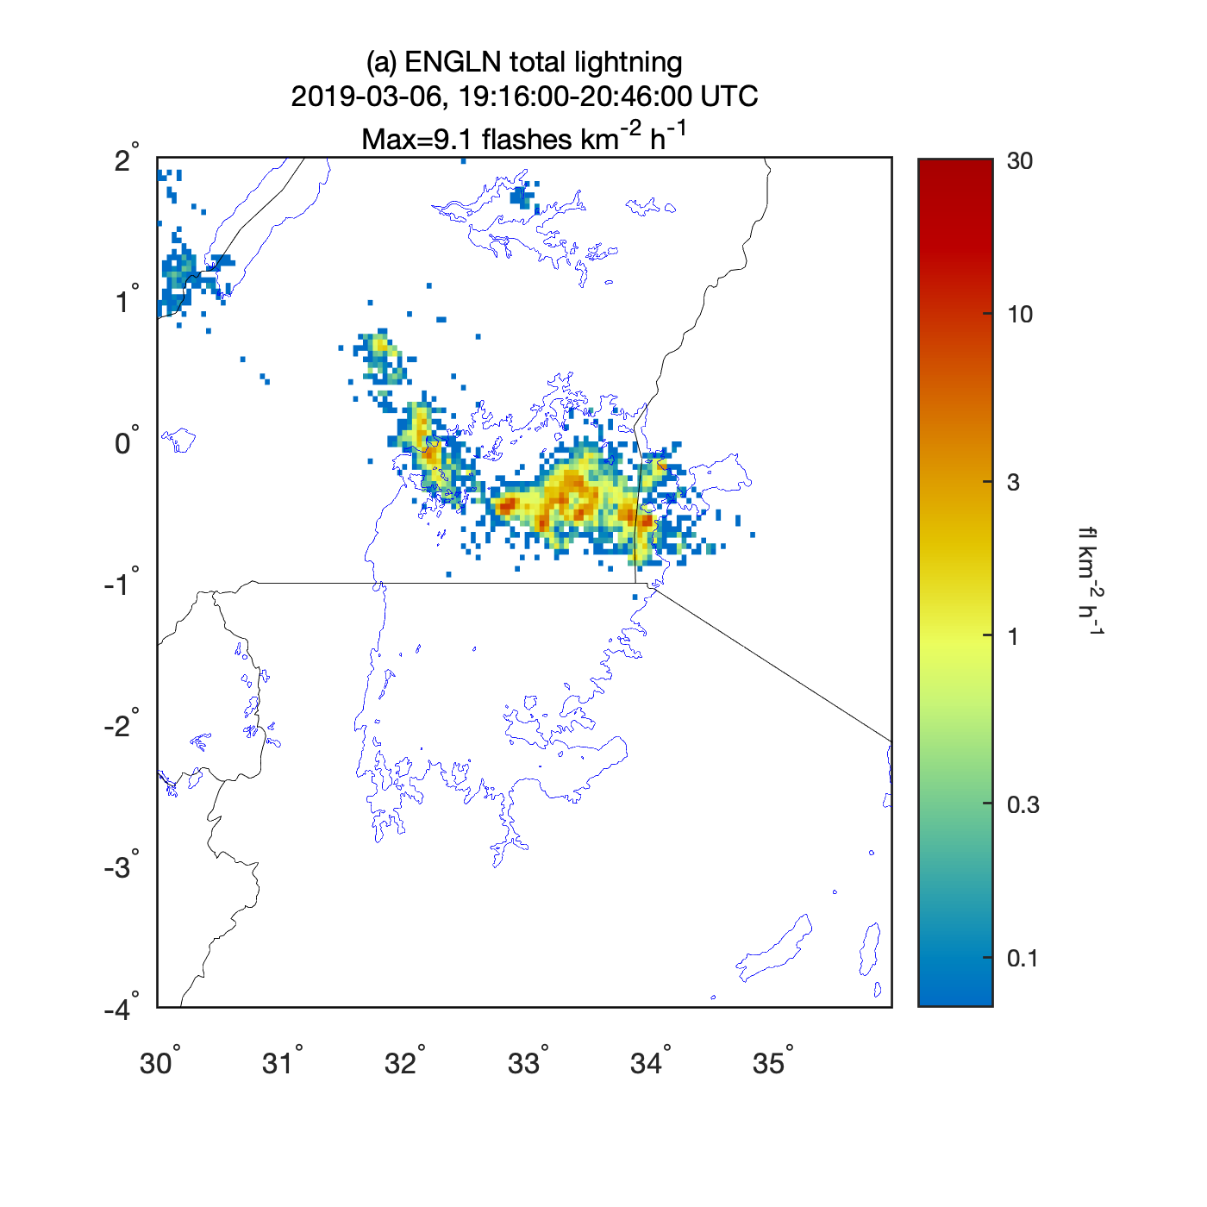
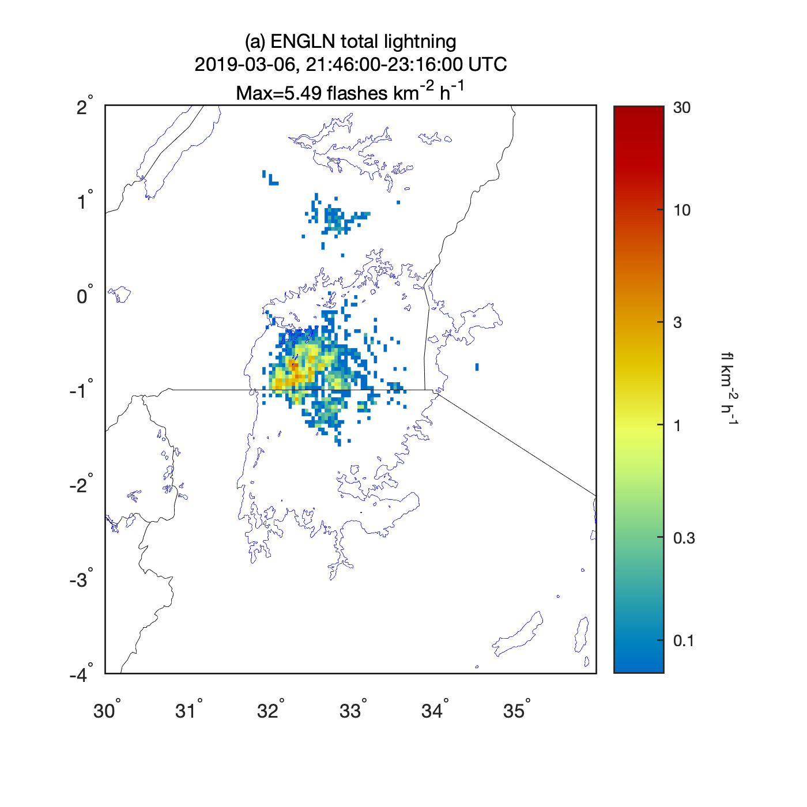
Total lightning from ENGLN – top (color-coded by time - 90 min); bottom (LI synthetic imagery - 0.04 deg accumulated flashes)
Notes:
ENGLN Total Lightning:
(top) 90 min color coded every 3 min,
(bottom) 90 min flash density (FED at 0.04 deg) – corresponds to TA4 model grid and MTG LI pixel at nadir

Slide 12
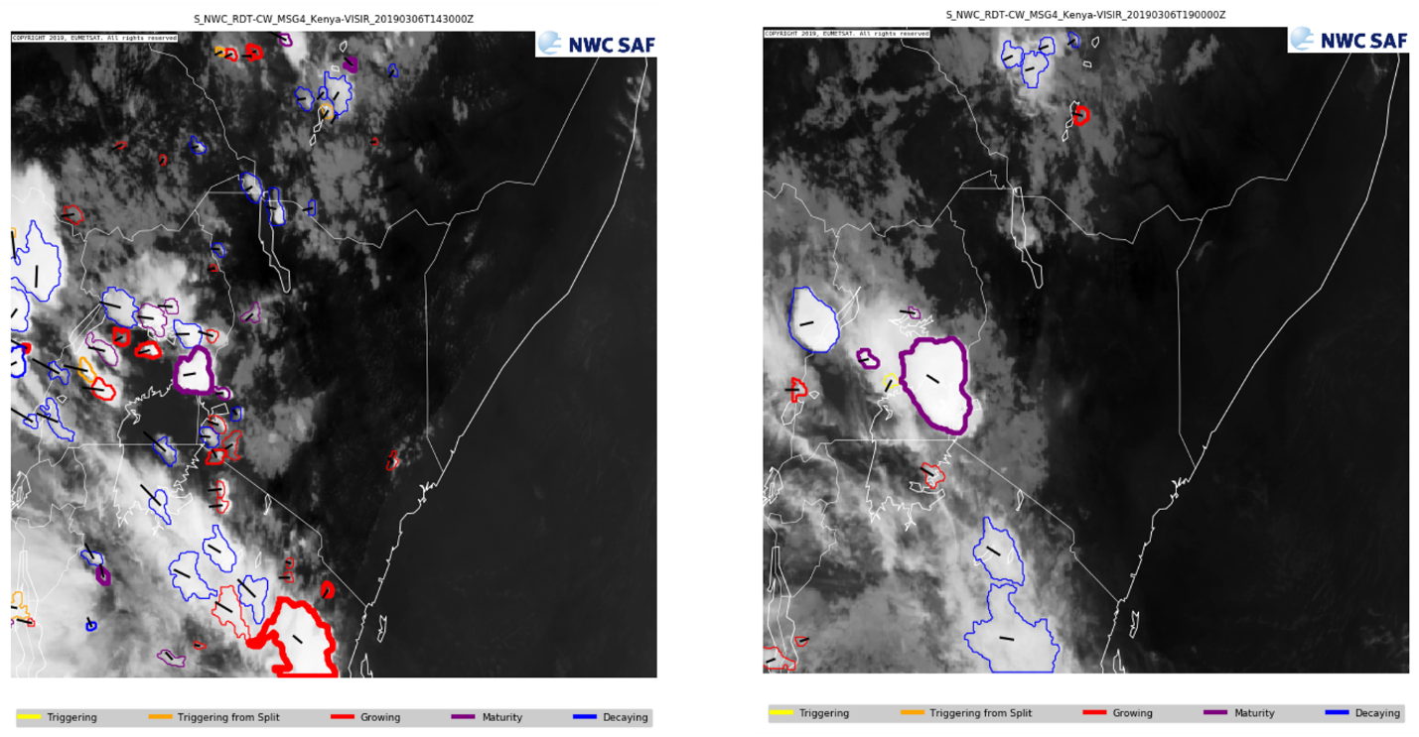
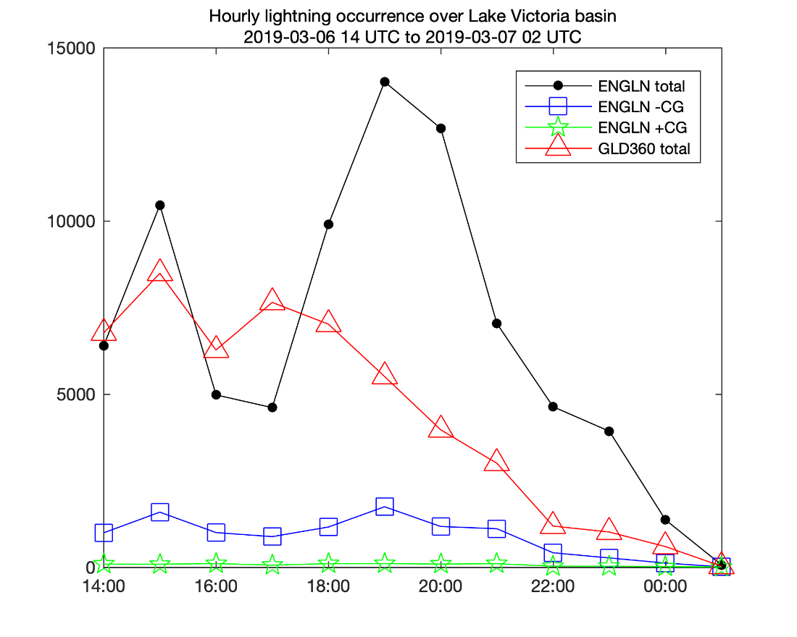
RDT 1430 UTC
RDT 1930 UTC
MTG-LI Synthetic imagery (0.04 deg)

Slide 13
Summary, Results and Implications for MTG IRS, FCI, LI
Highway Project - Lake Victoria Basin 2017 - 2021
marine forecast Capacity Building, Nowcasting and NWP training, and a learning experiment to understand the formation of thunderstorms over the lake
How good/useful is short-range NWP, including lightning forecast ?
WRF, ECMWF, UK MO TA4 (Tropical Africa 4.4 km operational model) – run at 06Z and 18Z
NWP viewed by EA NMHS forecasters as useful guidance, but does not provide sufficiently accurate timing and location to offer actionable information
MTG FCI/IRS offer improvements to the global models- no additional plans for TA4 at this time
What can satellite (imagery, lightning) products provide ? - to complement NWP or diagnose the pre-storm/near-storm environment and convection when sparse or absent radars (CI, boundary interactions, rapid development)
EUMETSAT SAF RDT, CRR, MTG LI lightning jump, FED, MFA, TOE, ProbSevere? Nearcast?
NASA Lightning Forecast Algorithm (LFA), MTG LI lightning data assimilation
ProbSevere, Nearcast and LFA developed under the GOES-R PGRR Science Program
What lightning data sets are available and of what data quality?
ENGLN, GLD360 preparation/complementary for MTG LI (total, IC, CG) – ENGLN over lake, GLD360 across LVB
Validate NWP WRF, TA4 (Wilkinson, 2017; McCaul et al, 2020); ECMWF (Philippe Lopez, 2016)
Notes:
New GEO-Ring to support the WMO WIGOS 2040 Vision.
Data sets archived at Met Office and at NCAR EOL field data catalog- https://data.eol.ucar.edu/project/HIGHWAY
MTG will be a transformational advancement for weather services throughout Africa providing 10-min full disk, multi-spectral imagery with greater spatial, temporal and spectral information from its FCI, 30-sec total lightning from its LI, and 6-hourly soundings over the LVB of the pre-storm and near-storm environment from its IRS, as well as sub-hourly soundings equivalent to those provided by MSG-SEVIRI from MTG-I channels. New satellite products will combine the lightning, imager, and sounder into a “seamless” 4-D data cube that can be combined with NWP and radar.
LI Flash Extent Density, Minimum Flash Area, Total Optical Energy

